Slide 1
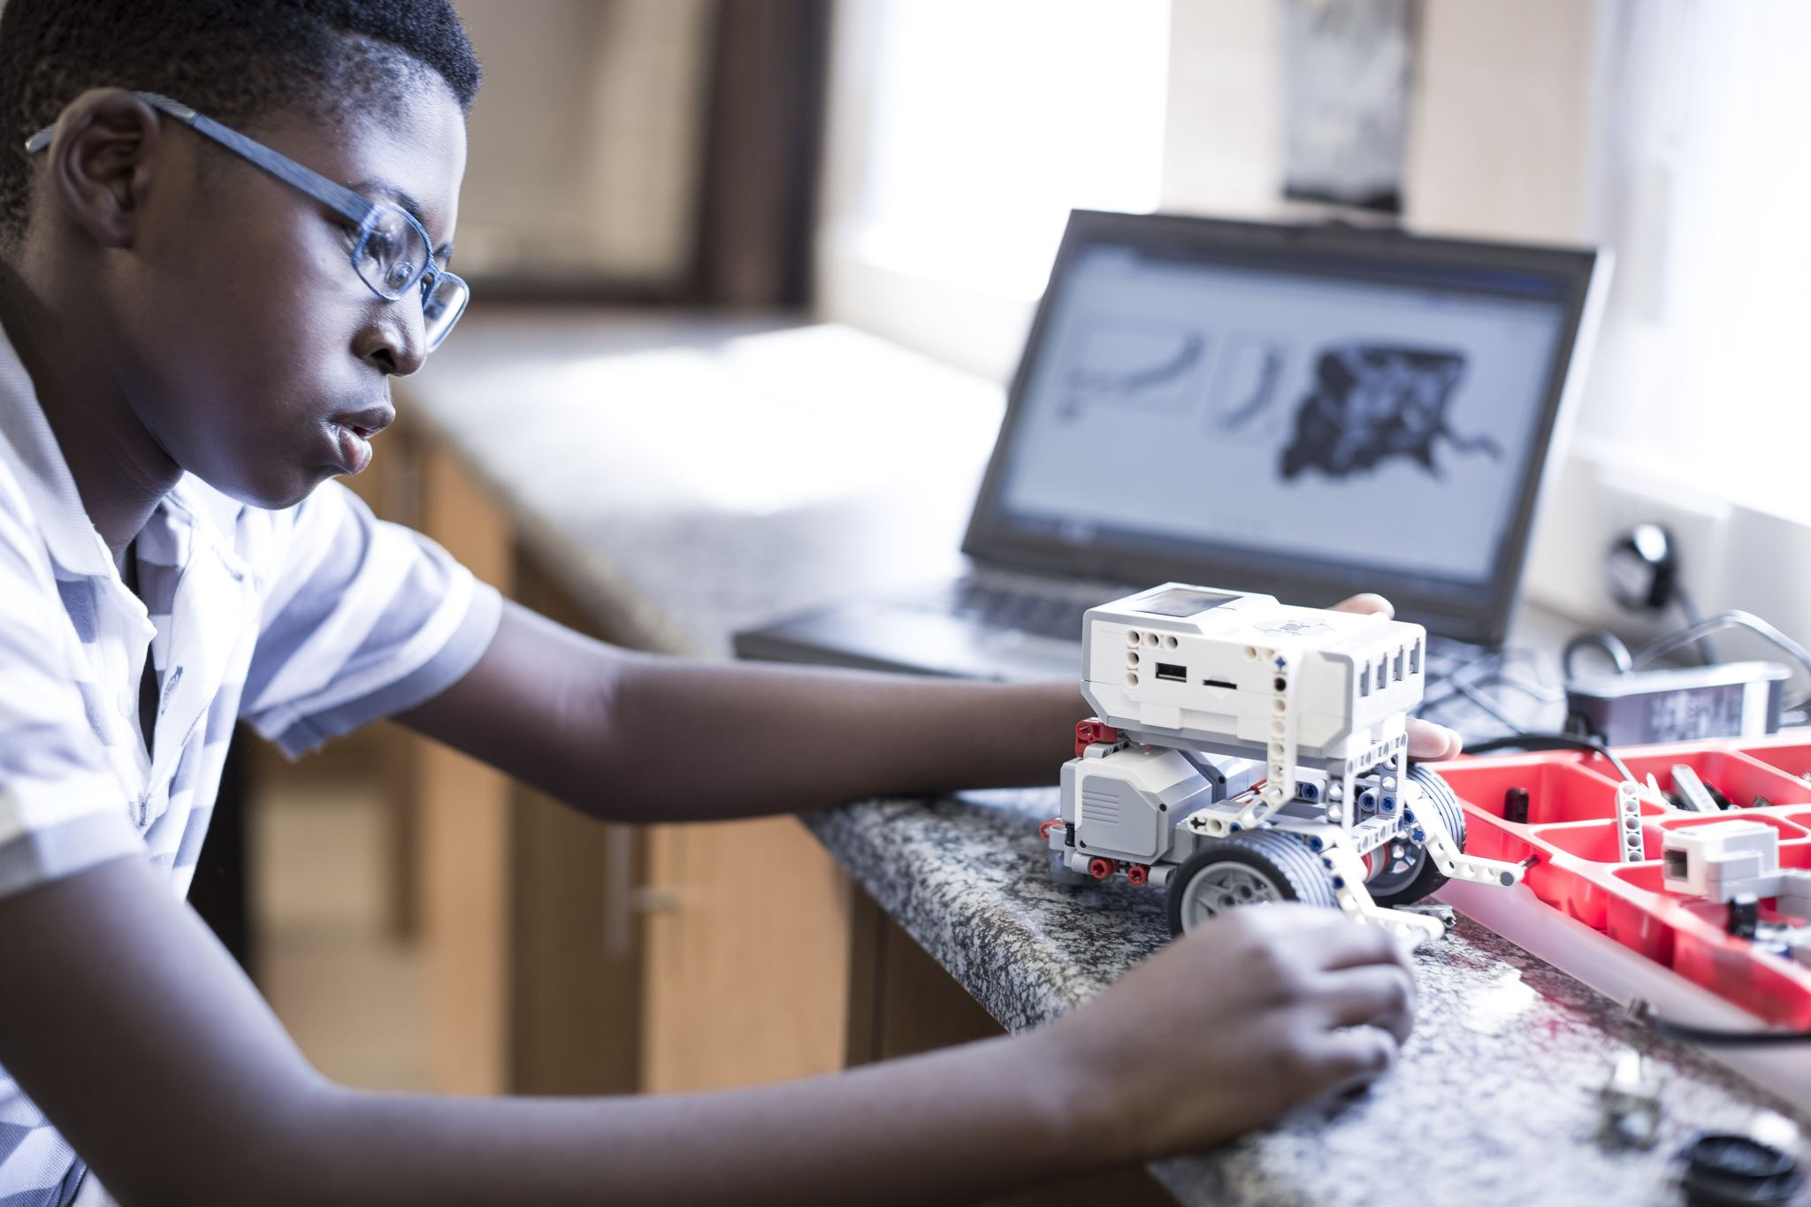

AJ RICKOFF Sessions
September 21 – November 11, 2021
All Rights Reserved by Camp Tech Inc.

Slide 2
Agenda
Overview
What is Camp Tech?
  A Space to Create Endless Possibilities
What is Technology?
  Technology Is A Systematic Approach To Doing Anything
Classroom Rules
Introductions – Mr. Scott / Mrs. B
Student Introduction
  Name/Age/What do you want to be when you grow up?
Camp Tech Assessment
  Camp Tech Login (www.camptechonline.com)
    Go to Students, then to Students Login
  Student Assessment
Create Folders - Each Student will create a folder on there computer
Things You Will Learn
  Camp NFT
  Camp Mobile
Camp Tech Rules
Have Fun + Speak when Spoken + Respect + Sanitized

Slide 3
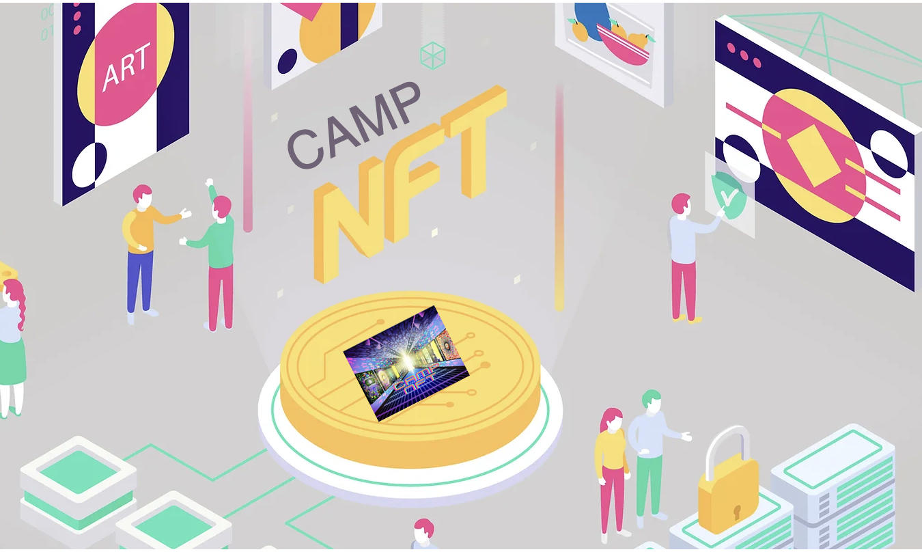
NEXT LEVEL GRAPHIC DESIGN
All Rights Reserved by Camp Tech Inc.

Slide 4
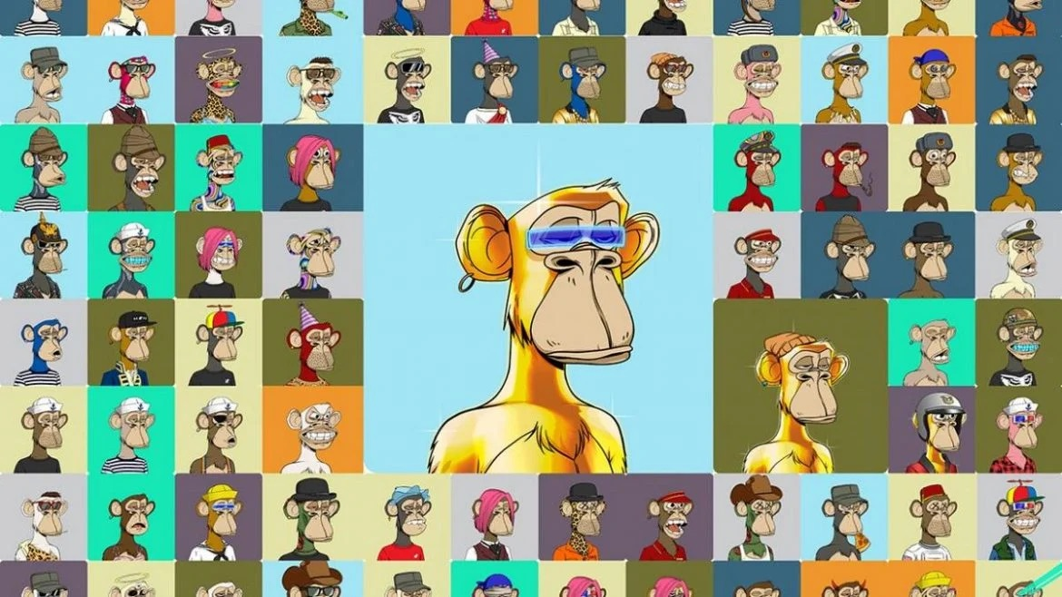
Camp (GD) NFT
Most Expensive NFT
Session 1 – Intro to Camp Tech / Assessment
Session 2 – What is Graphic Design?
Session 3 – Elements of Design
Session 4 – Graphic Design and AI
Session 5 – Create a logo, poster, flyer, t-shirt,
Session 6 – Intro to NFT - What is an NFT?
Session 7 – How to Create an NFT
Session 8 – NFT Presentations
All Rights Reserved by Camp Tech Inc.

Slide 5
Camp Tech Assessment
Camp Tech Login (www.camptechonline.com)
  Go to Students
  Go to Student Login
Student Assessment / Camp AI
  AutoDraw
  QuickDraw

Slide 6
Intro to Graphic Design
What is Graphic Design?
Learn how to Draw with a mouse
  Pixal Art
  Digital Paint
Learn how to Draw with AI
  AutoDraw
  QuickDraw
Learn the Elements of GD

Slide 7
What is Graphic Design?
Graphic Design is the art and practice of planning and projecting ideas and experiences with visual and textual content. In other terms, graphic design communicates certain ideas or messages in a visual way.

Slide 8
Elements of Graphic Design
Elements of Design
Fonts
Color
Audience
Message

Slide 9
Graphic Design AI
Learn how to Draw with AI
  AutoDraw
  QuickDraw

Slide 10
Graphic Design Overview and Projects
Color Theory
Font Review
Draw your portrait
Create a logo
Create a Flyer
Create a Poster
Create a Tik Toc Video\\\
Canva Student login
Email: camptechkids@gmail.com
Password: 4thekids

Slide 11
Logo Game
Name the Logo

Slide 12
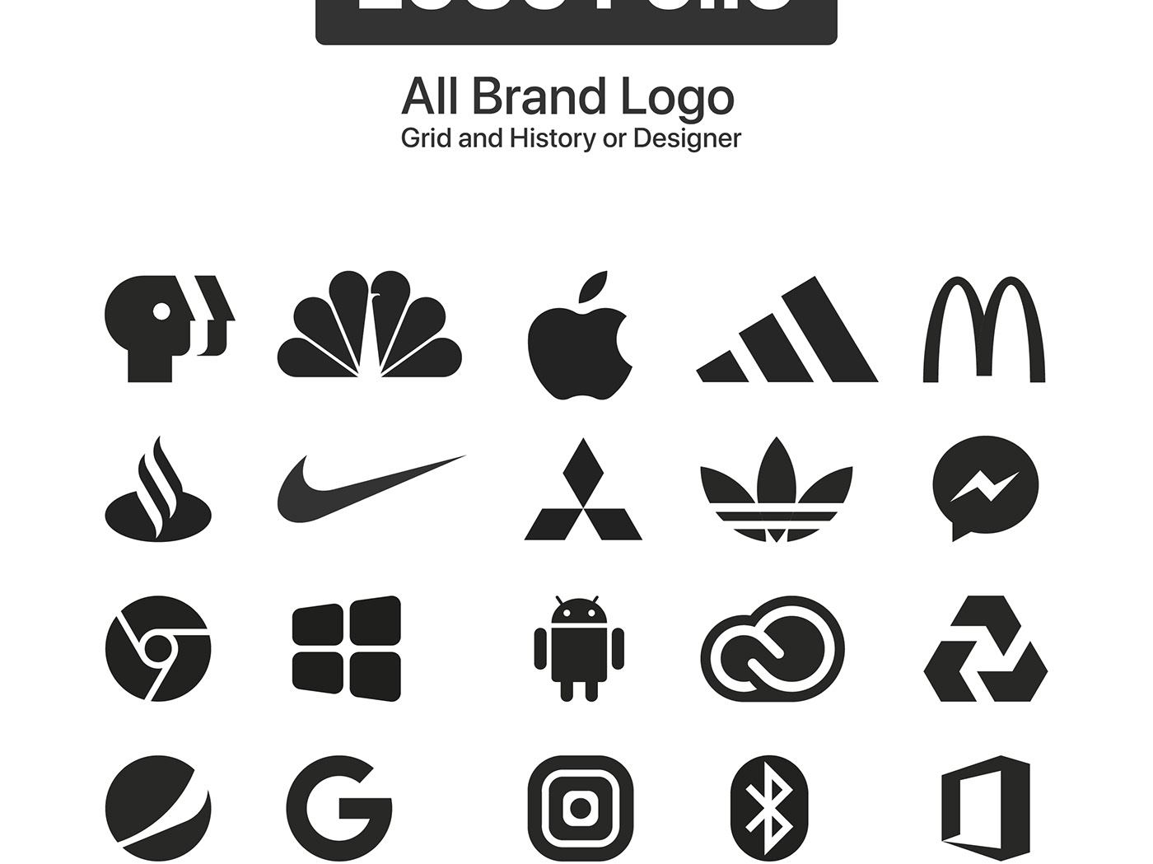
Identify the Logos

Slide 13

Name the Logos

Slide 14
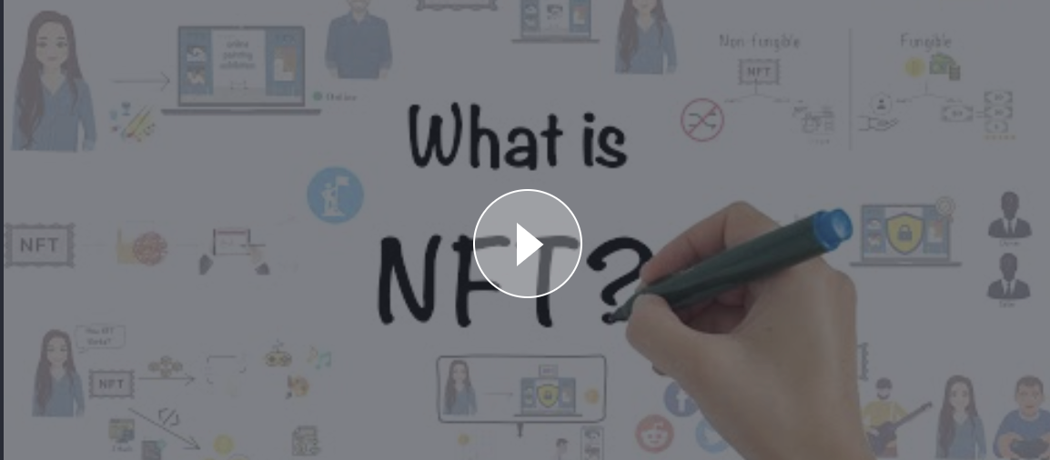
What is an NFT?
What is an NFT?
NFTs in a nutshell
First, the technical definition: An NFT (“non-fungible token”) is a unit of data stored on a digital ledger, called a blockchain.
An NFT is a digital asset that can be owned, sold and traded. But that’s just scratching the surface. NFTs will be the atomic unit of ownership across the metaverse.
In simpler terms: NFT means your digital asset is completely unique and non-replaceable. It can then be “tokenized,” so you can transfer ownership (i.e. sell) to your fans. Fans can resell your NFT on marketplaces like Opensea (read more about that here). After that, you’ll get a 7% royalty of the resale price, every single time it’s resold. If your NFT increases in value over time, your profits will reflect that. They’re real money makers and community builders.
NFTs: Digital collectibles
NFTs aren’t so different from selling merch…
NFTs as digital collectibles act as a support mechanism. Now, let’s put this into context when thinking about selling merch on Spring. Why do your fans buy your physical merch?
To financially support you as a creator.
To receive something that proves they are a dedicated fan of your content. Bragging rights.
Because they like the design, the artwork, and the creativity you’ve applied to the product.

Slide 15
History of NFTs
Most Expensive NFT

Slide 16
How to Create a NFT?
OPEN SEA
Bleepes
Explore NFTS
Mint on Demand

Slide 17
NFT Process
Develop a Graphic
Submit your graphic to an NFT platform
Await First Sale

Slide 18
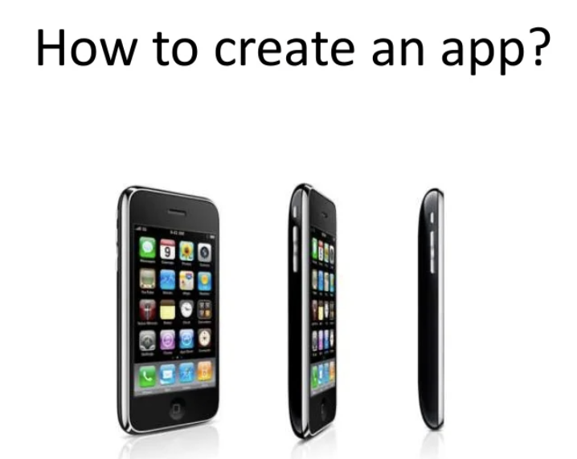
CAMP MOBILE
Caption

Slide 19
Camp Mobile
Session 1 – Intro to Mobile APP
Session 2 – Brain Storming
Session 3 – Develop Your Idea
Session 4 – Develop Prototype
Session 5 – Create Mobile
Session 6 – Test your app
Session 7 – Create Pitch – Share Pitch
Session 8 – Mobile APP Presentation

Slide 20
Intro to Mobile App

Slide 21
Brainstorming

Slide 22
Develop Your Idea

Slide 23
Develop Prototype

Slide 24
Create your Mobile

Slide 25
Test Your App

Slide 26
Create your Pitch

Slide 27
Mobile App Presentation

Slide 28
Next Slides
Camp Toyland
Camp AI

Slide 29
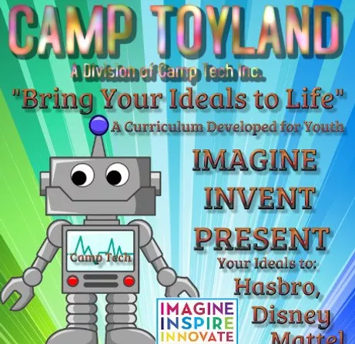
Training Material
All Rights Reserved by Camp Tech Inc.

Slide 30
Camp Toyland
Session 1 – Camp Toyland Overview
Session 2 – Brain Storming
Session 3 – Develop Your Idea
Session 4 – Develop Protype
Session 5 – Create Game/Toy
Session 6 – Test your game or toy
Session 7 – Create Pitch – Share Pitch
Session 8 – Pitch Presentation – Winner Announced
All Rights Reserved by Camp Tech Inc.

Slide 31
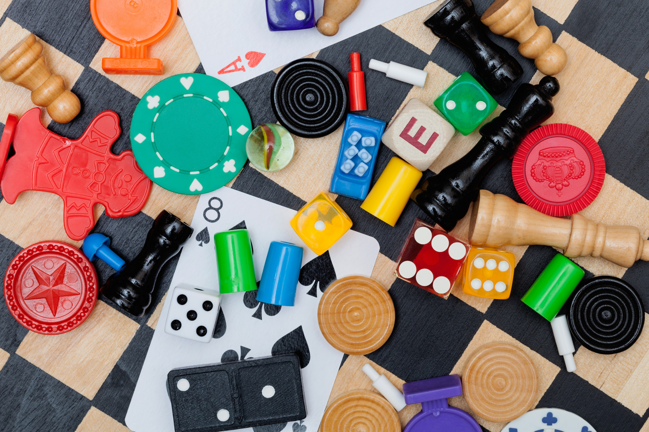
CAMP TOYLAND
Re-Image Your Favorite Board or Card Game
All Rights Reserved by Camp Tech Inc.

Slide 32
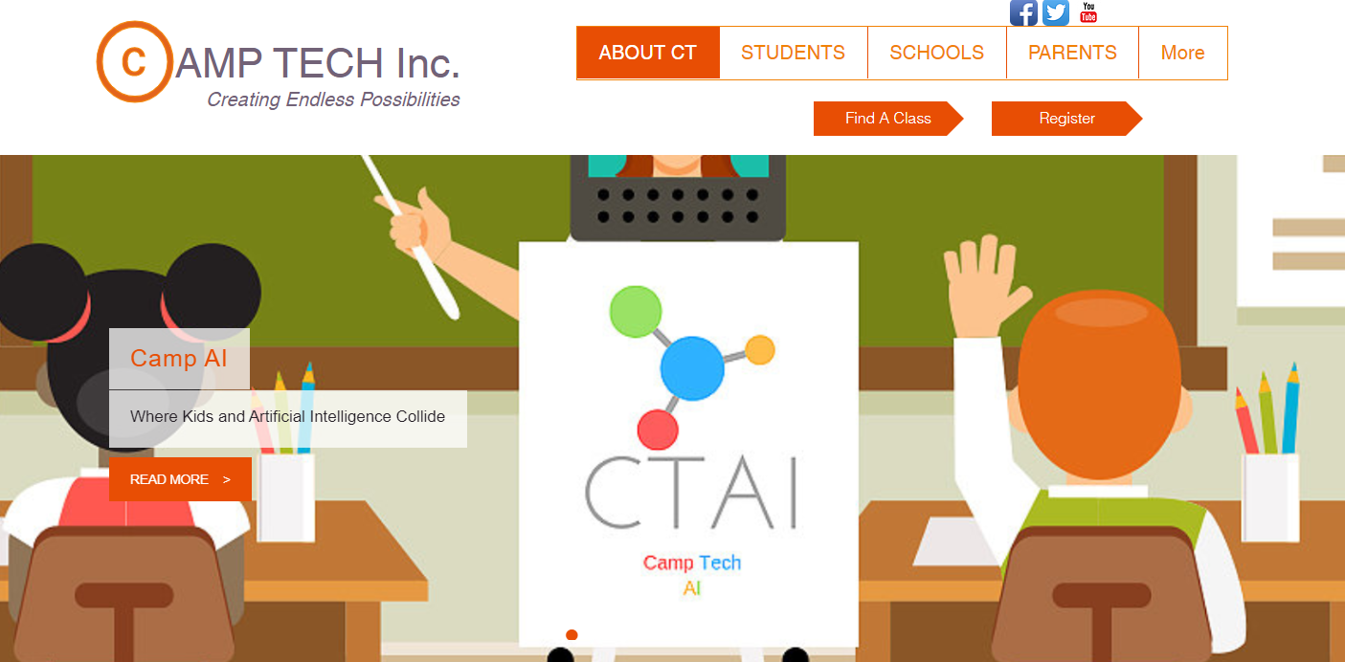
Training Material
All Rights Reserved by Camp Tech Inc.

Slide 33
Camp AI
Session 1 – What Is Artificial Intelligence?
Meet Robi * Meet George * Meet Alexa/Siri
Session 2 – Avatar Creation
Session 3 – Conduct an Orchestra
Session 4 – Develop Protype
Session 5 – Hip Hop Bot
Session 6 – Shadow Art
Session 7 – Teachable Machine
Session 8 – AI Duet
All Rights Reserved by Camp Tech Inc.

Slide 34

www.camptechonline.com
Create Endless Possibilities
All Rights Reserved by Camp Tech Inc.

